Slide 1
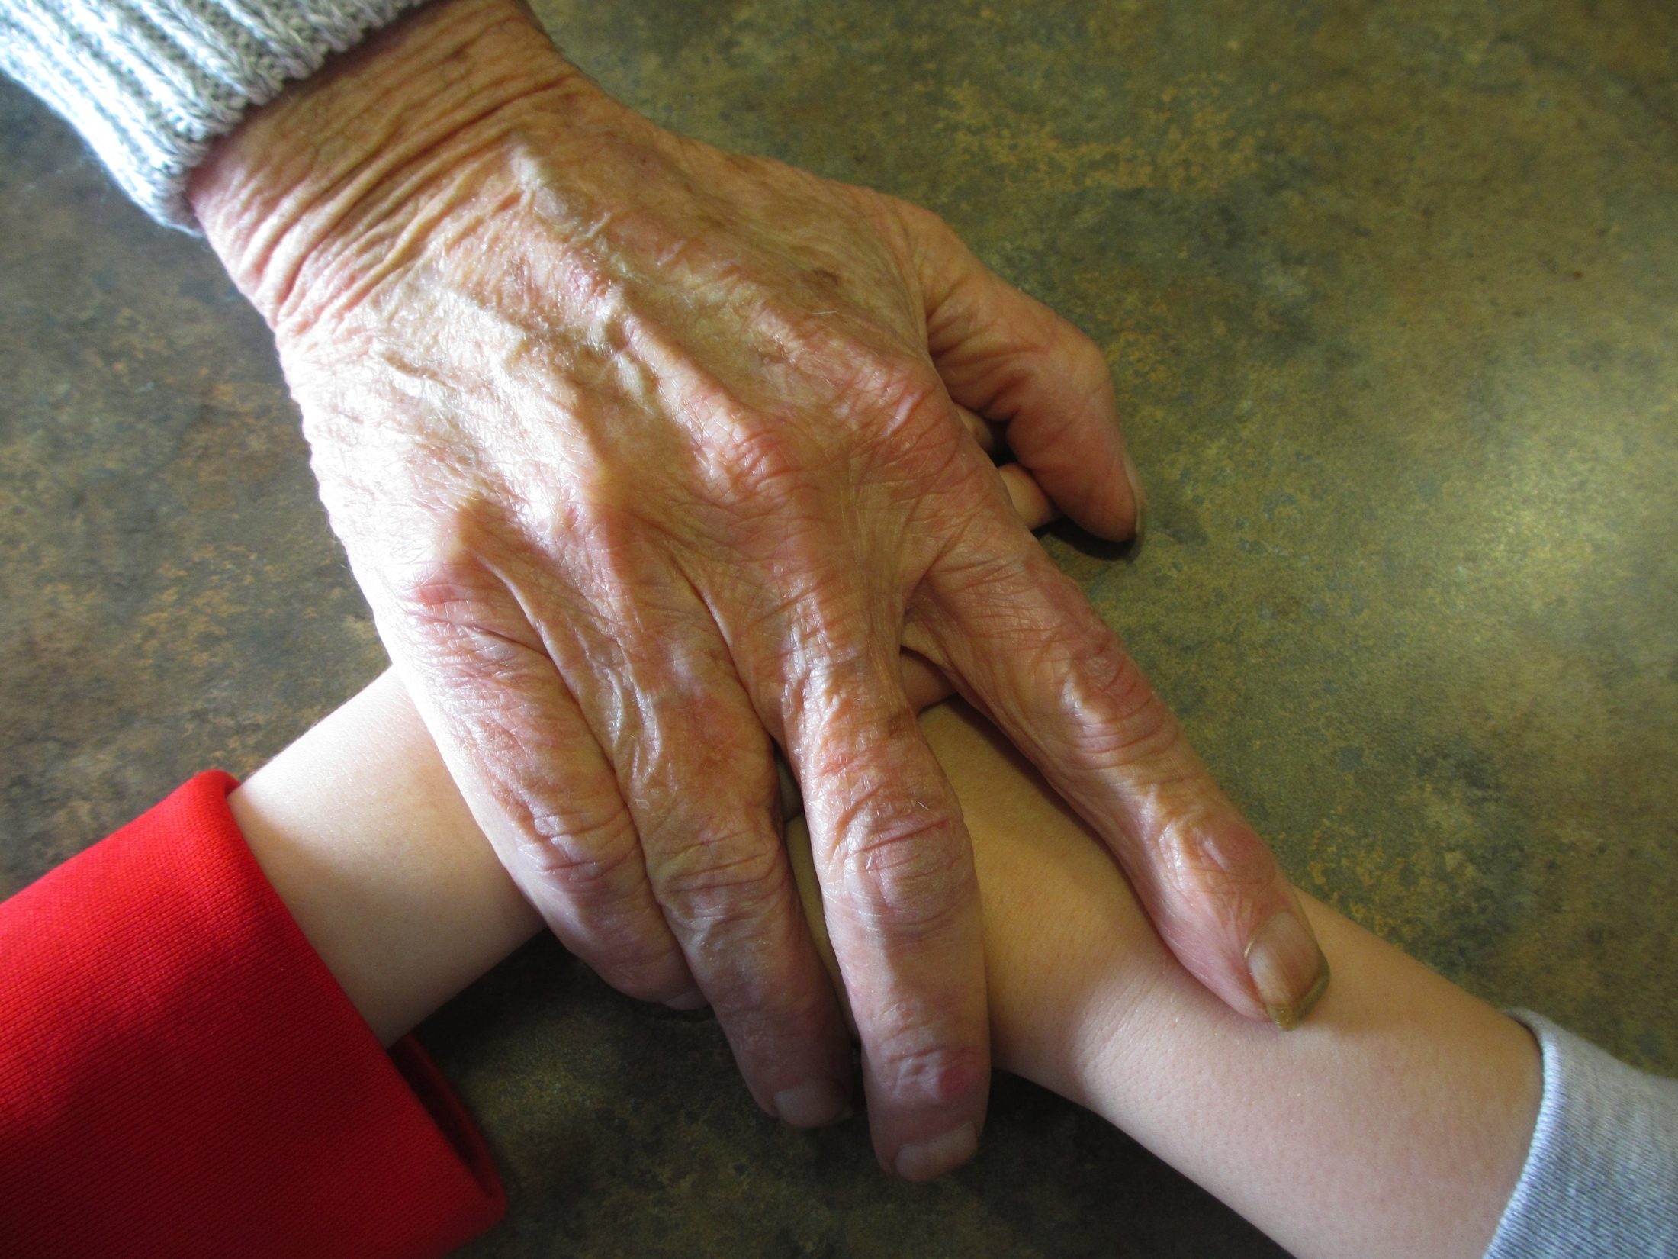
Intergenerational Learning Creating Magical Moments
EDCI 554 A01
Sandra A. Beckett
Student # V00106819
University of Victoria
Notes:
This template can be used as a starter file for presenting training materials in a group setting.
Sections
Sections can help to organize your slides or facilitate collaboration between multiple authors. On the Home tab under Slides, click Section, and then click Add Section.
Notes
Use the Notes pane for delivery notes or to provide additional details for the audience. You can see these notes in Presenter View during your presentation.
Keep in mind the font size (important for accessibility, visibility, videotaping, and online production)
Coordinated colors
Pay particular attention to the graphs, charts, and text boxes.
Consider that attendees will print in black and white or grayscale. Run a test print to make sure your colors work when printed in pure black and white and grayscale.
Graphics, tables, and graphs
Keep it simple: If possible, use consistent, non-distracting styles and colors.
Label all graphs and tables.

Slide 2
“The quality of a nation is reflected in the way it recognizes that its strength lies in its ability to integrate the wisdom of its elders with the spirit and vitality of its children and youth”.
Margaret Mead (1971)

Slide 3
Inspiration:
-Inspired by a colleague’s experiences and promise of “a million magic moments”, I began taking my kindergarten class on weekly visits to an assisted living facility three years ago.
-Participants in this program – children, residents, families, and staff – engage in multiple social, educational and magical moments.
-Everything I have witnessed from this experience leads me to believe intergenerational programs are not only beneficial for early childhood development, but also for the residents.
Notes:
Give a brief overview of the presentation. Describe the major focus of the presentation and why it is important.
Introduce each of the major topics.
To provide a road map for the audience, you can repeat this Overview slide throughout the presentation, highlighting the particular topic you will discuss next.

Slide 4
Objectives:
-Intergenerational learning programs provide opportunities for sharing of time, development of relationship and reciprocal learning between generations.
-“Intergenerational programs are designed to engage non-biologically linked older and younger persons in interactions that encourage cross-generational bonding, promote cultural exchange, and provide positive support systems that help to maintain the well-being and security of the younger and older generations” (Newman, 1997, p.56).
Notes:
Give a brief overview of the presentation. Describe the major focus of the presentation and why it is important.
Introduce each of the major topics.
To provide a road map for the audience, you can repeat this Overview slide throughout the presentation, highlighting the particular topic you will discuss next.

Slide 5
Inquiry:
“How can I improve intergenerational relations and programming specific to kindergarten children visiting an assisted living facility each week?”
In teaching we follow our instincts and embrace opportunities that are authentic and inspiring. Intergenerational learning feels right on multiple levels. My goal in selecting intergenerational learning as a research topic is to scrutinize my personal experiences using research and case studies.
Notes:
Give a brief overview of the presentation. Describe the major focus of the presentation and why it is important.
Introduce each of the major topics.
To provide a road map for the audience, you can repeat this Overview slide throughout the presentation, highlighting the particular topic you will discuss next.

Slide 6
Theory:
-Sociocultural theories align with the social nature of learning imbedded in intergenerational programs. Intergenerational learning promotes social justice and equity as does pedagogy of societal reconstruction theory (Whiteland, 2013).
-Dewey’s foundational theory of reciprocal giving of knowledge and skills is supported by findings of Kenner, Ruby, Jessel, Gregory & Arju, (2007), in which intergenerational interactions are shared with participants as equitable co-constructors of events (Felten & Clayton, 2011).
-Vygotsky’s sociocultural theory affirms learning in a cultural community through zone of proximal development and considers affects of social relationships on cognitive development (Knight, Skouteris, Townsend & Hooley, 2014 ).
-Erikson’s model of psychosocial development theorizes fulfillment increases through generativity – the need to guide the next generation – and identity formation (Holmes, 2009).
Notes:
Give a brief overview of the presentation. Describe the major focus of the presentation and why it is important.
Introduce each of the major topics.
To provide a road map for the audience, you can repeat this Overview slide throughout the presentation, highlighting the particular topic you will discuss next.

Slide 7
Benefits:
-Shared, meaningful, socially relevant learning opportunities between the generations.
-Promotion of and embodiment of lifelong learning.
-Augmentation of self-esteem and confidence through valued contributions.
-Elimination of age-segregation and anti-aging attitudes through empathy, understanding and tolerance.
-Increased physical and mental wellness.
-Increased social connectedness and opportunity for socially acceptable incidents of human touch.
-Meaningful and genuine relationships develop between diverse age groups.
Notes:
Give a brief overview of the presentation. Describe the major focus of the presentation and why it is important.
Introduce each of the major topics.
To provide a road map for the audience, you can repeat this Overview slide throughout the presentation, highlighting the particular topic you will discuss next.

Slide 8
Considerations:
-Current knowledge of intergenerational learning is based on practice more that research.
-Perceptions of early childhood, aging, and elderly must be understood in relation to ages and developmental stages.
-Collaboration, equality in decision-making, reciprocity of contributions, and benefit to all ages determine the depth of the relationship and context for transformative learning.
-If intergenerational programs with young children and older adults are to be considered service learning they need to include an element of reflection.
Notes:
Give a brief overview of the presentation. Describe the major focus of the presentation and why it is important.
Introduce each of the major topics.
To provide a road map for the audience, you can repeat this Overview slide throughout the presentation, highlighting the particular topic you will discuss next.

Slide 9
Questions Revealed:
-Do intergenerational programs actually allow participants to work collaboratively, with reciprocity and equity to decision-make and determine activities and program goals? (Smith & Yeager, 2008).
-What considerations are critical to developing quality intergenerational learning programs.
-How can professionals attain skills and knowledge needed to invest in and implement an intergenerational program?
Notes:
Give a brief overview of the presentation. Describe the major focus of the presentation and why it is important.
Introduce each of the major topics.
To provide a road map for the audience, you can repeat this Overview slide throughout the presentation, highlighting the particular topic you will discuss next.

Slide 10
Professional Perspective:
-In an era of age segregation, frenetic lifestyles and increased time and attention diverted to technology over humanity, intergenerational learning is needed by society.
-Increased involvement in quality intergenerational programs will only be achieved when educators and health care professionals become invested in intergenerational ways.
-All participants must be equitable co-constructors of programs and activities.
-Professional development opportunities and quality resources are essential components to increased implementation of intergenerational learning programs.
Notes:
Give a brief overview of the presentation. Describe the major focus of the presentation and why it is important.
Introduce each of the major topics.
To provide a road map for the audience, you can repeat this Overview slide throughout the presentation, highlighting the particular topic you will discuss next.

Slide 11
Conclusions:
-Literature overwhelmingly supports positive benefits of intergenerational programs (Dunham & Casadonte, 2009).
-Intergenerational learning programs are suited to all ages, but within the public school system have particular advantages to kindergarten as social and emotional goals are inherent and curriculum is less restrictive.
-The key to success and growth of intergenerational learning programs includes continued research, well-founded professional development, and useful resources to support interactions and education of people of diverse ages.
Notes:
Give a brief overview of the presentation. Describe the major focus of the presentation and why it is important.
Introduce each of the major topics.
To provide a road map for the audience, you can repeat this Overview slide throughout the presentation, highlighting the particular topic you will discuss next.

Slide 12
Intentions:
-The key to success and growth of intergenerational learning programs includes continued research, well-founded professional development, and useful resources.
-I intend to create a resource that links professionals to research, implementation strategies, and activities to advance intergenerational programs.
-A series of lesson plans linked to the Kindergarten Curriculum Package (2010, British Columbia Ministry of Education) will be a component of this resource.
Notes:
Give a brief overview of the presentation. Describe the major focus of the presentation and why it is important.
Introduce each of the major topics.
To provide a road map for the audience, you can repeat this Overview slide throughout the presentation, highlighting the particular topic you will discuss next.

Slide 13
References:
Dunham, C.C. & Casadonte, D. (2009). Children’s Attitudes and Classroom Interaction in an Intergenerational Education Program. Educational Gerontology. 35(5), 453-464. doi:10.1080/03601270802605473
Felten, P. & Clayton, P.H. (2011) Service-Learning. New Directions for Teaching and Learning. 2011(128), 75-84.
doi: 10.1002/tl.470
Holmes, C. (2009). An Intergenerational Program with Benefits. Early Childhood Education. 37(2), 113-119.
doi: 10.1007/s10643-009-0329-9
Kenner, C., Ruby, M., Jessel, J., Gregory, E., & Arju, T. (2007). Intergenerational learning between children and grandparents in
east London. Journal of Early Childhood Research. 5(3), 219-243.
Knight, T., Skouteris, H., Townsend, M., & Hooley, M, (2014). The Act of Giving: Systematic Review of Nonfamilial Intergenerational Interaction. Journal of Intergenerational Relationships. 12(3), 257-278.
doi: 10.1080/15350770.2014.929913
Newman, S., Ward, C.R., Smith, T.B., Wilson, J.O., McCrea, J.M. (1997). INTERGENERATIONAL PROGRAMS: Past, Present, and Future. New York: Routledge.
Smith, B.J. & Yeager A. (2008). Intergenerational Communities. Child & Youth Services. 20(1-2), 25-32.
doi: 10.1300/JO24v20n01_03
Whiteland, S. (2013). Picture Pals: An Intergenerational Service-Learning Art Project. Art Education. 66(6), 20-26.
Retrieved from: http://web.a.ebscohost.com.ezproxy.library.uvic.ca/ehost/pdfviewer/pdfviewer?sid=2643366e-59b2-45a6-b43c-e735ee552d15%40sessionmgr4002&vid=1&hid=4109

